Slide 1


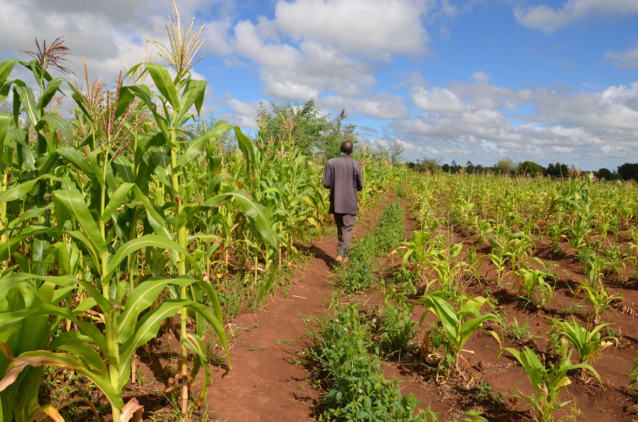

TAMSAT-ALERT for Impact-Based Forecasting
Session 2: Methodology Part 2
Notes:
Welcome to the next session in our course on TAMSAT-ALERT for Impact-Based Forecasting. This session focuses on methodology. In Part 2, we will be exploring the TAMSAT-ALERT approach to risk assessment.

Slide 2
Learning objectives
Explain TAMSAT-ALERT soil moisture and WRSI as a drought impact-relevant metric
Understand modelling of soil moisture and WRSI
Understanding TAMSAT-ALERT approach to forecasting
Ability to interpret TAMSAT-ALERT soil moisture and WRSI forecasts
Ability to produce TAMSAT-ALERT forecast plots and/or bulletins
Notes:
You will remember that we set out several learning objectives for the course as a whole. This session will help you understand our approach to forecasting.

Slide 3
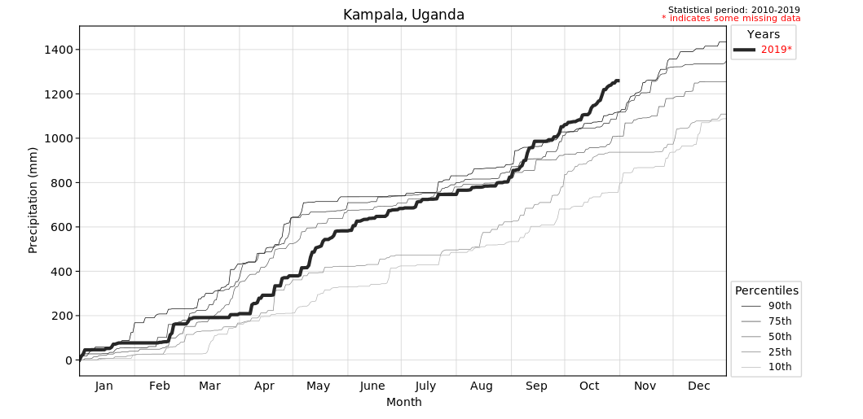
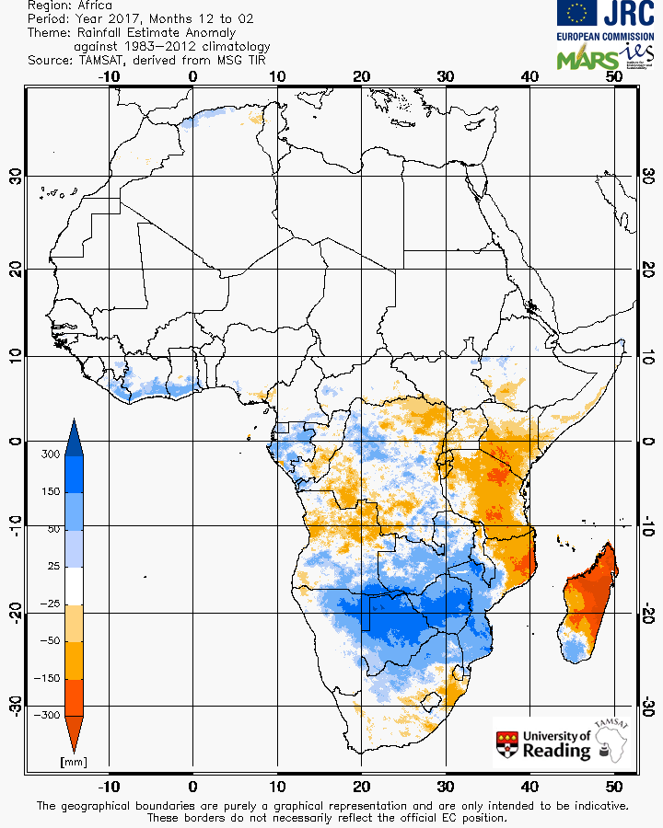
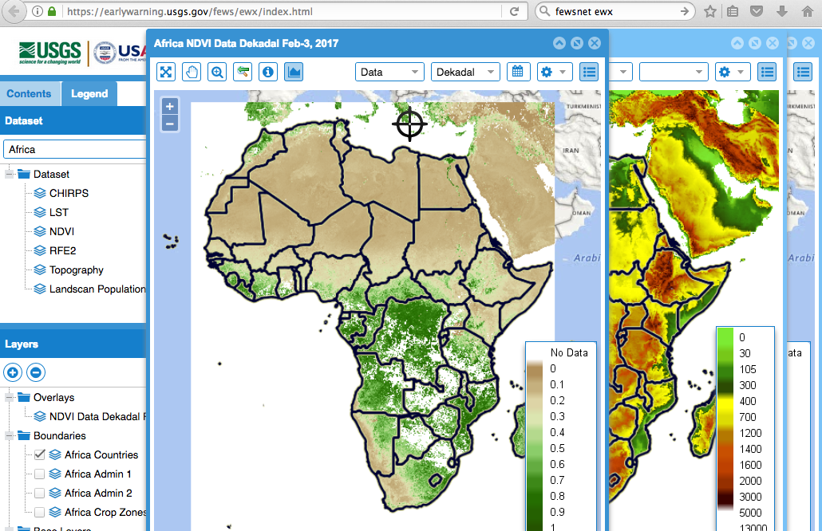
Approaches to early warning: Monitoring of environmental conditions
Rainwatch
TAMSAT
FEWSNET early warning explorer
Notes:
Before we move onto our approach to forecasting, we will review some of the methods already used for early warning of a developing drought. I hope it will then become clear that our method – the TAMSAT-ALERT framework – brings together and complements existing methods, and works alongside them, to help you interpret the multiple sources of information available to you.
The first type of early warning is based on monitoring of meteorological and environmental conditions. The plots in this slide illustrate several useful approaches. On the left, we have a screenshot from the Rainwatch system. Rainwatch takes high quality station data from meteorological services and compares observed rainfall in the season so far against the climatological percentiles. This allows the user to see whether the rain is higher or lower than the climatology.
The plot on the right gives an example of a satellite based rainfall estimate. Satellite data is particularly useful in Africa, where stations are sparse, because it provides a continent wide view of rainfall.
Finally, sophisticated systems such as the FEWSNET early warning explorer, shown on the bottom plot, enable the user to compare a wide variety of satellite observations, including vegetation condition and temperature.

Slide 4
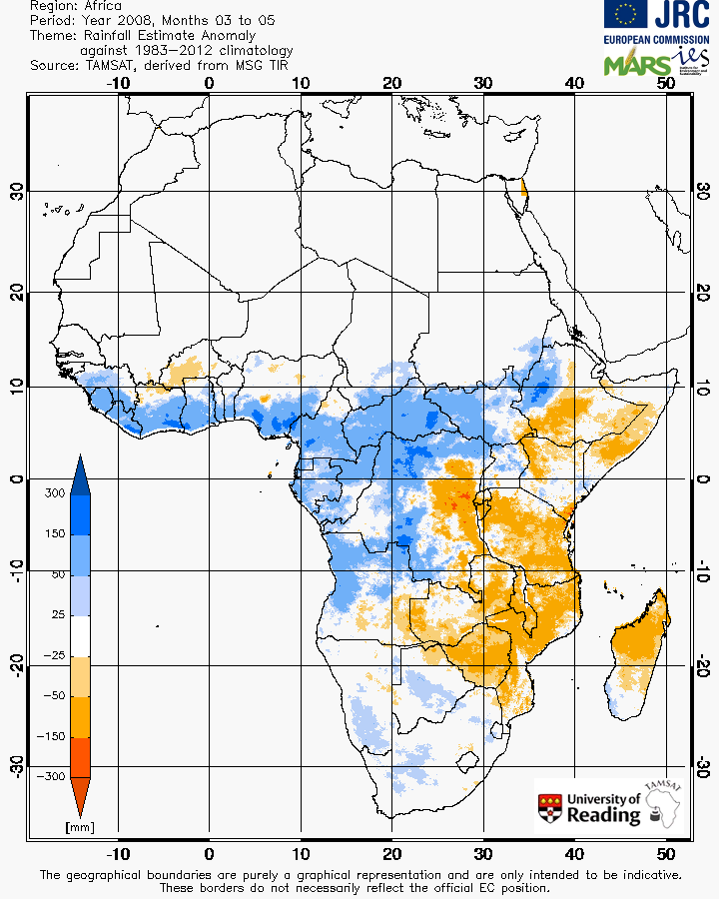
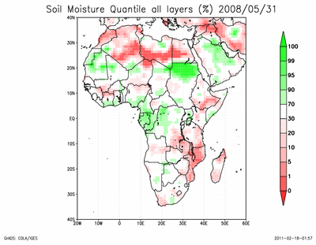
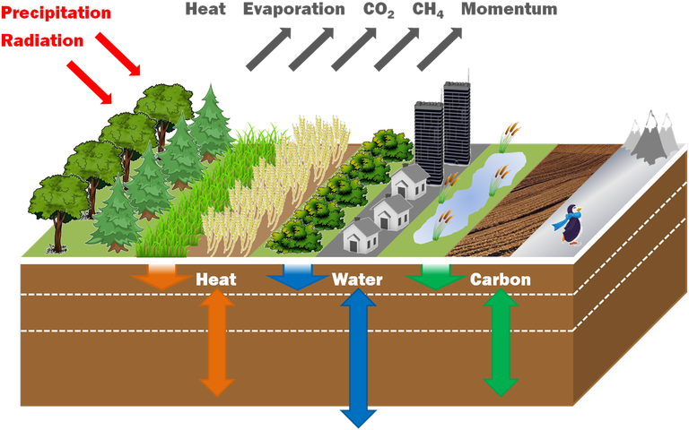
Approaches to early warning: Snapshot of soil moisture
Meteorological input
Soil moisture based drought metric
Land surface model
Notes:
The next type of early warning information available to users are snap shots of soil moisture and other drought metrics, often calculated using a land surface model. We went into some detail about how these drought metrics are calculated in the previous session.
The plot above illustrates how meteorological input is processed by a land surface model into an estimate of soil moisture.

Slide 5
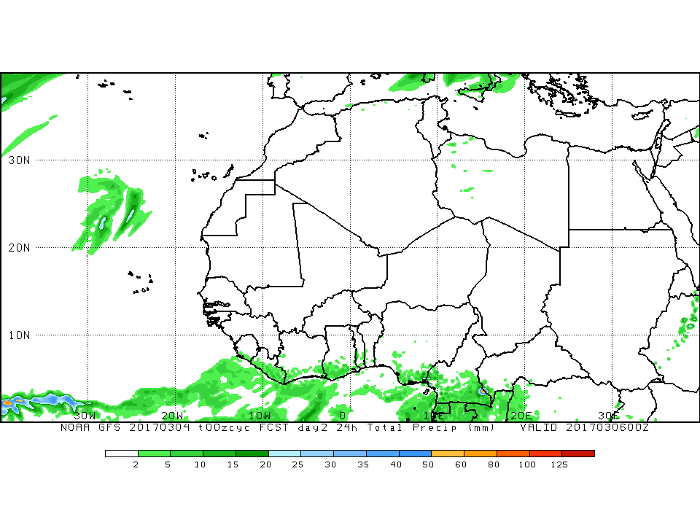
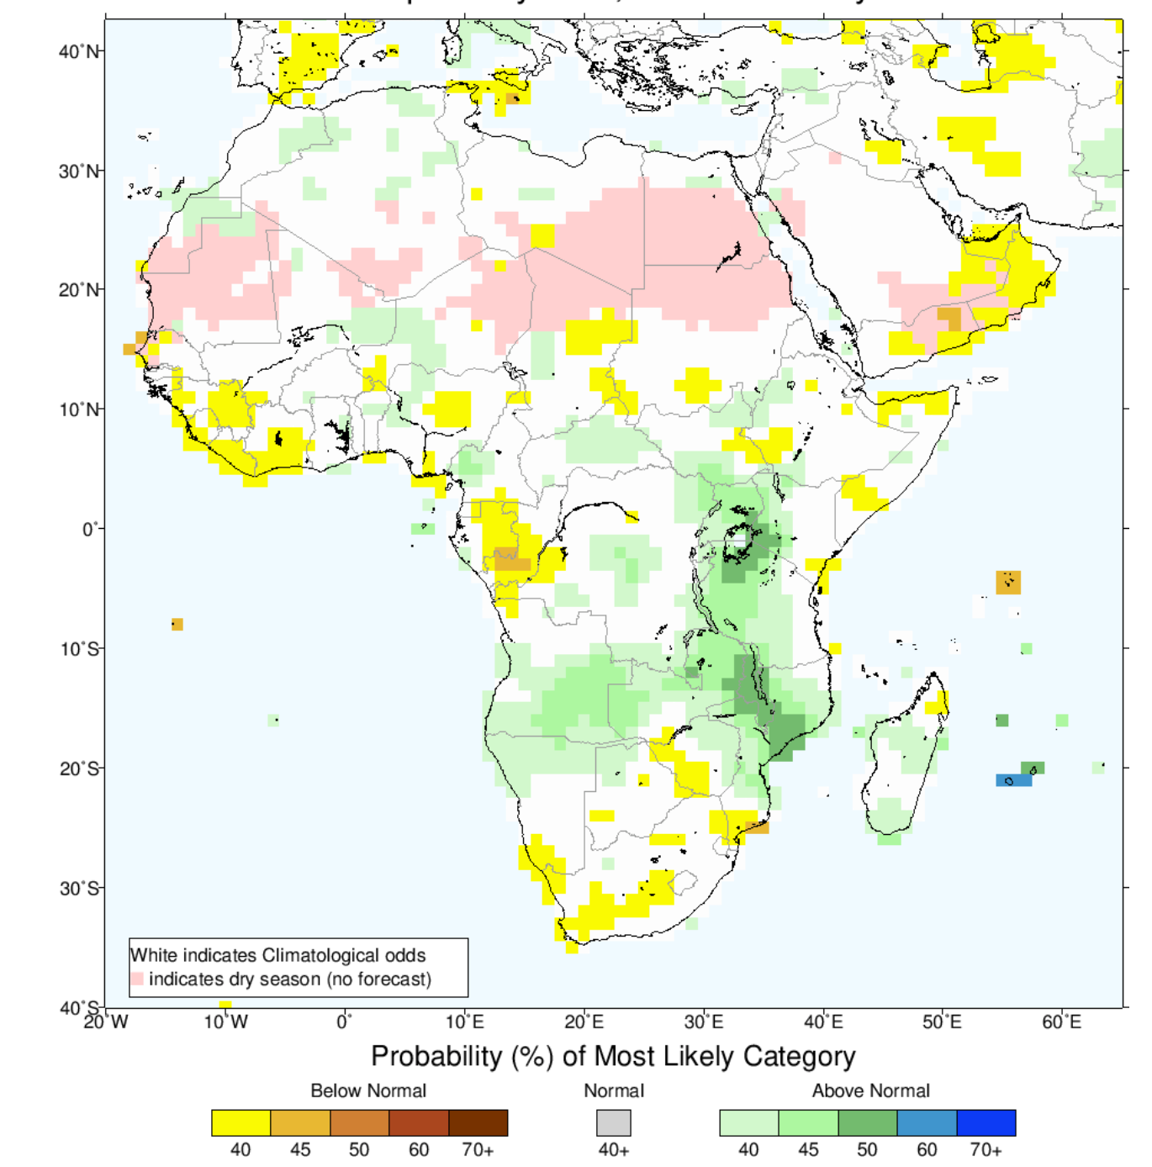
Approaches to early warning: Meteorological forecasts days to months ahead
IRI seasonal forecast
Met office 24-hour forecast
Notes:
The final piece of information available for early warning are meteorological forecasts. These may be on time scales of days to seasons. The information may be presented as probabilities or as deterministic predictions.
The plots above give examples of several types of forecast information. The forecast on the left is a UK Met Office 24 hour rainfall forecast. On the right, we see a probabilistic forecast of rainfall. The shading shows the probability of the most likely tercile. Another session will explore in more detail how to interpret this type of forecast.

Slide 6
TAMSAT-ALERT: Overview
Given the:
climatology
state of the land surface
stage of the rainy season
meteorological forecast
What is the likelihood of some adverse event?
…low cumulative rainfall, low soil moisture, low yield, seedling death
Notes:
All of these pieces of information are useful. However, combining them into actionable risk assessment is a challenge for users. In order to meet this challenge, we developed the TAMSAT-ALERT framework. TAMSAT-ALERT brings the types of information described in the previous slides together into objective risk assessments of adverse conditions, for example low seasonal cumulative rainfall, low soil moisture, low yield or seedling death.
Specifically, TAMSAT-ALERT uses a formal statistical framework to address the question: Given the local climatology, the state of the land surface – whether it is wet or dry, the stage of the season and the meteorological forecast, what is the probability of some adverse event.

Slide 7
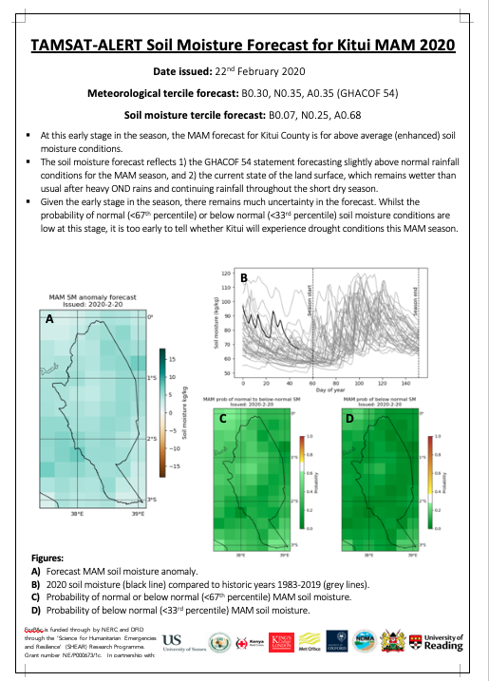
TAMSAT-ALERT: Overview
Notes:
Here we see some outputs from the TAMSAT-ALERT system. On the left is an example bulletin, which we prepared in collaboration with the National Drought Management Authority in Kenya. This particular bulletin was for the Kitui county in Kenya. It is for the last season. The plot on the left (plot A) shows the predicted soil moisture for the region. Plot B shows the evolution of the soil moisture so far during the season over the region as the bold line; the pale grey lines show the evolution of soil moisture in previous years for this particular region, enabling the user to make a comparison. The two plots on the bottom right show the probability of average to below average rainfall, and of below average rainfall. These probabilistic forecasts will be the focus of a separate session.
On the right are forecasts of the WRSI anomaly for a wider region, which we discussed in the previous session.

Slide 8
TAMSAT-ALERT: How does it work?
Diagnostic calculation
Impact model
Metric
Ensembles Probabilities
Notes:
The rest of this session will focus on how the TAMSAT-ALERT system works.
Agricultural risk depends on meteorological conditions over a period of time, which may be a few days for seed germination, or several months, for example for crop yield. The TAMSAT-ALERT thus combines the real time monitoring done by systems like rainwatch with forecast information. The system is designed to bring these sources of information together. In the first stage of the process, we ask the question:
Given the current state of the land surface, the local climatology and the stage of the growing season, what is the probability of some adverse outcome? In order to do this, we drive a soil moisture model with meteorological data. The soil moisture model was the subject of the previous session.
For the past, it is straightforward. We use meteorological observations. For the future, however it is not as straight forward. We do not know what the weather will be like. Another way of expressing this is to say that there are many possible weather futures. For example, in one possible weather future, it might be mild and wet tomorrow; another possible weather future is that it is hot and dry.
In order to represent the future weather using TAMSAT-ALERT, we need to drive the system with a range of possible future weather trajectories.
There are many ways of formulating these weather futures. In the TAMSAT-ALERT system, we use the local weather in past years as the possible weather futures. Say, at our point of interest, in 1983, on May 1st – May 10th it was wet and cold, and in 1984, it was hot and dry – two of our weather futures would be the 1983 wet and cold weather, and the 1984 hot and dry weather. In TAMSAT-ALERT, we tend to use 15-30 past years to generate a wide range of possible weather futures.
The example, just described, illustrates some advantages of this approach. Firstly, we take into account the usual weather at our point of interest – in other words – the local climatology. Secondly – we capture the complex interactions between different aspects of the weather. For example, hot weather in a region might more frequently associated with dry conditions than with wet conditions and the extent to which this is true will vary from one region to another. Thirdly, we avoid having an artificial jump from the past observations to the future for which obsevations are not available.
Moving onwards, the meteorological data is combined into multiple possible time series. Each time series incorporates the past observations spliced together with one possible weather future. These time series drive the land surface model, creating an ensemble of possible soil moisture time series. The ensemble can then be analysed to generate probabilistic assessments.

Slide 9
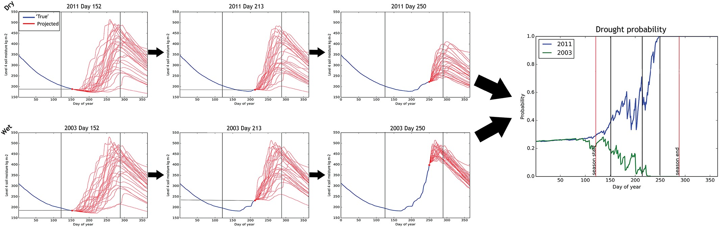
TAMSAT-ALERT: How does it work?
Progression of the season
Notes:
The working of the TAMSAT-ALERT system is illustrated in this slide, which shows the system in action for a wet year (bottom set of plots) and a dry year (top set of plots) in Ghana.
Starting with the plots on the left… On the day of each hind cast, we initiate the land surface model with multiple possible weather futures, creating multiple possible soil moisture futures. The soil moisture based on observations is shown as a blue line and the possible futures are shown as red lines. We can see that as we go through the season, during our period of interest, shown as the vertical lines, we gradually have more observed information to work with.
On each day of the year during our season, we can do a statistical comparison between our ensemble and the climatology for the region. This enables us to calculate the probability of drought on each day. At the beginning of the season, before we have any other information, this is close to the climatological probability (33%). As we add in extra observations, we start to see clearly whether there will be a drought or not. This process is illustrated by the plot on the right, which shows that by half way through the season we can say with reasonable confidence that during the wet year, a drought will not happen, and that in the dry year, a drought will happen.
Looking at the shape of the predicted soil moisture for the multiple weather futures, we can see that we are capturing the local climatology. By initiating the forecasts from our simulated land surface on each hindcast date, we are incorporating the state of the land surface, and by incorporating the historical data, we are allowing for the stage of the rainy season. These risk assessments thus address the question:
What is the probability of drought, given the local climatology, the state of the land surface and the stage of the rainy season?

Slide 10
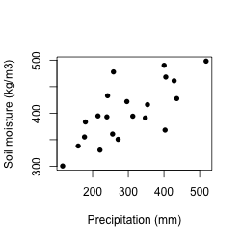
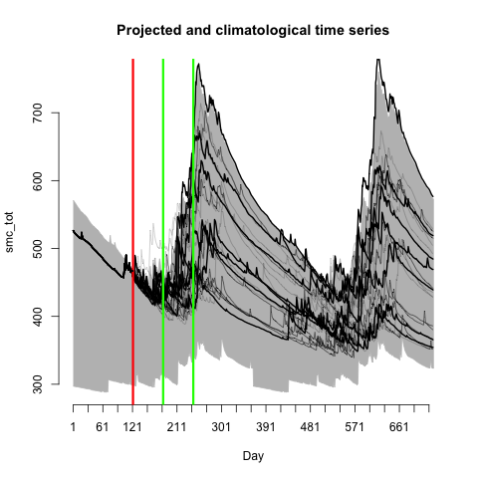
TAMSAT-ALERT: How does it work?
The meteorological forecast is used to favour some ensemble members more than others.
Each analogue year (future weather) is weighted according to the meteorological variable being forecast.
Disconnect between the meteorological variable being forecast and the metric being assessed will result in the meteorological forecast having less effect
The soil moisture model is not forced directly with forecast model output because forecast models are systematically biased, which makes it impossible to achieve continuity with forcing with
Seasonal forecast can be implicitly downscaled to a point
Drought metric
Meteorological variable
Notes:
There is one element that the previous assessment does not account for, and that is the meteorological seasonal forecasts that we described earlier in this session.
In the calculations described in the previous slide, we assume that each of the possible weather futures is equally likely. In the TAMSAT-ALERT system, we use meteorological seasonal forecasts to judge how likely each possible weather future is.
For example, if our seasonal forecast for a region is that the bottom tercile (T1) has a probability of 21%, and that the middle tercile (T2) has a probability of 35% and the upper tercile (T3) has a probability of 44%, we can use this information to determine how likely each of our weather futures is. The reason we can do this is that our weather futures are based on real years from the past. So if our prediction is for regional rainfall, and regional rainfall in 1991 was in the the bottom tercile (T1), we assign the ensemble member associated with 1991, a probability of 21%. If the regional rainfall in 1992 was in the top tercile (T3), we assign the ensemble member associated with 1992 a probability of 44%. And so on.
There are several advantages to using this approach rather than an informal approach of using the seasonal rainfall forecast to qualitatively comment on the likelihood of drought. Although precipitation is strongly linked to soil moisture deficit, the relationship isn’t perfect. The plot on the left shows our meteorological prediction plotted against our drought metric for several past years. We can see that whilst there is a strong positive relationship, sometimes we have high precipitation and low soil moisture, and vice versa. The reasons for this lie in the complex relationship between meteorological and agricultural drought, described in the previous session. In our method, in cases where the relationship between the meteorological variable being forecast and the drought metric being assessed is weak, the meteorological forecast will have little effect on our drought assessment. The weighting of the ensemble will be equivalent to assigning weights to each ensemble member randomly.
The method thus implicitly accounts for mismatch between meteorological forecasts and agricultural drought risk assessments.
In a similar manner, the method implicitly downscales the meteorological seasonal forecast data to the scale at which we are conducting the drought risk assessments. The plot on the uses line weightings to illustrate how the meteorological forecasts can be used to weight our soil moisture ensemble. The grey shaded area shows the climatology, the red vertical line shows the day of the hindcast and the green lines encase the period of interest.

Slide 11
Key points
Agricultural risk depends on the evolution of environmental conditions over a period of time, ranging from days to months. In season risk assessments thus need to account for both what has happened so far during our period of interest (for example, our growing season) and what may happen in the remainder of the season
Risk assessments also need to account for regional variation in climate
People responsible for early warning need a method for combining multiple sources of information into objective and quantitative assessments of risk. This is a key element of impact-based forecasting.
TAMSAT-ALERT meets these requirements by addressing our initial question:
Given the climatology, state of the land surface, stage of the rainy season and meteorological forecast, what is the probability of some adverse event?
We are working with many meteorological services, and other authorities in Africa to develop their capacity to use and generate TAMSAT-ALERT forecasts. If you want to use this system, please get in touch!
Notes:
Some of the material in this session was quite complex, but you do not need to understand the full workings of TAMSAT-ALERT to make use of the forecasts.
Here are a few key points:
Agricultural risk depends on the evolution of environmental conditions over a period of time, ranging from days to months. In season risk assessments thus need to account for both what has happened so far during our period of interest (for example, our growing season) and what may happen in the remainder of the season
Risk assessments also need to account for regional variation in climate
People responsible for early warning need a method for combining multiple sources of information into objective and quantitative assessments of risk. This is a key element of impact-based forecasting.
TAMSAT-ALERT meets these requirements by addressing our initial question:
Given the climatology, state of the land surface, stage of the rainy season and meteorological forecast, what is the probability of some adverse event?
We are working with many meteorological services, and other authorities in Africa to develop their capacity to use and generate TAMSAT-ALERT forecasts. If you want to use this system, please get in touch!

Slide 12
Next steps
Do the multiple-choice quiz to cement your understanding
Explore the additional reading and other resources listed in the ‘Additional resources’ document
Ask the TAMSAT team any questions you have [e.c.l.black@reading.ac.uk]

